Slide 1
TREES
UNIT - 4

Slide 2
Syllabus
General Trees , Tree Terminologies
Tree Representation , Tree Traversal
Binary Tree Representation , Expression Trees
Binary Tree Traversal , Threaded Binary Tree
Binary Search Tree :Construction, Searching Insertion and Deletion
AVLTrees: Rotations , Insertions
B-Trees Constructions , B-Trees Search
B-Trees Deletions, Splay Trees
Red Black Trees , Red Black Trees Insertion

Slide 3
General Trees
Linear access time for linked lists too high.
Solution – group data into trees.
Trees – non linear data structure
Used to represent data contains a hierarchical relationship among elements example: family, record
Worst Case time – O(log n)
Tree can be defined in many ways, eg: recursively

Slide 4
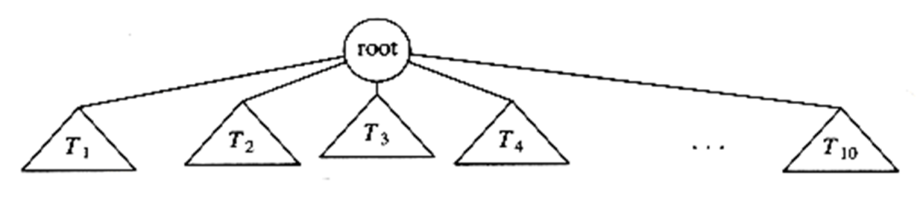
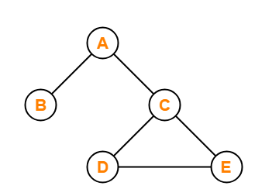
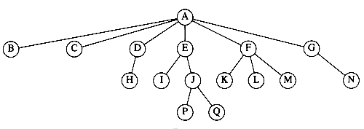
General Trees
Tree consists of collection of nodes arranged in hierarchical pattern
Tree - Examples
Not a tree

Slide 5
Tree Terminology
Root
Edge
Parent
Child
Sibling
Degree
Internal node
Leaf node
Level
Height
Depth
Subtree
Forest
Path
Ancestor
Descendant

Slide 6
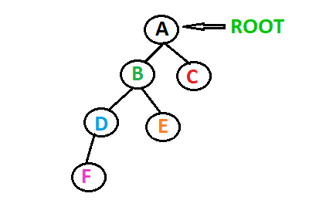
Tree Terminology - Root
The stating node of a tree is root node
Only one root node

Slide 7
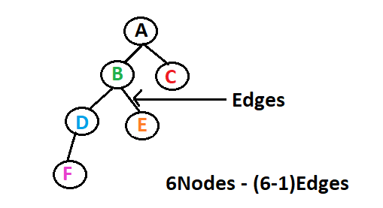
Tree Terminology - Edge
Nodes are connected using the link called edges
Tree with n nodes exactly have (n-1) edges

Slide 8
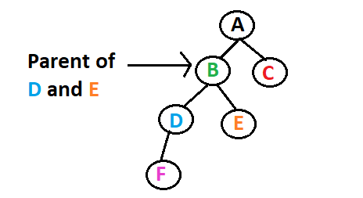
Tree Terminology - Parent
Node that have children nodes or have branches connecting to other nodes
Parental node have one or more children nodes

Slide 9
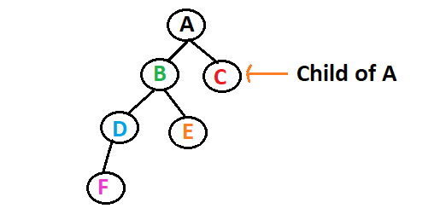
Tree Terminology - Child
Node that is descendant of any node is child
All nodes except root node are child node

Slide 10
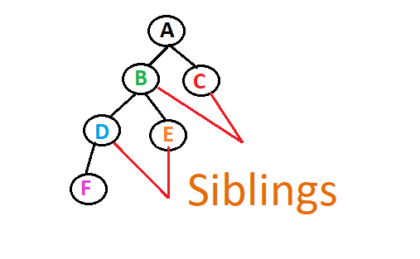
Tree Terminology - Siblings
Nodes with same parents are siblings

Slide 11
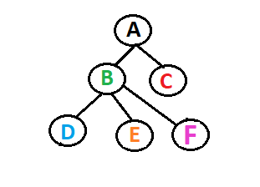
Tree Terminology - Degree
Degree of node – number of children per node
Degree of tree – highest degree of a node among all nodes in tree
Degree A – 2
Degree B – 3
Degree C – 0
Degree D – 0
Degree E – 0
Degree F – 0
Degree of entire tree - 3

Slide 12
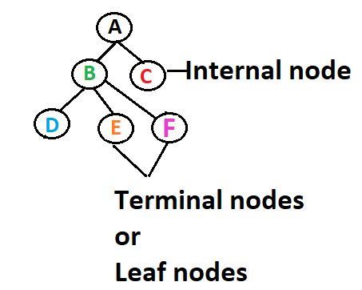
Tree Terminology – Internal Node
Node with minimum one child – internal node
Also known as non – terminal nodes

Slide 13
Tree Terminology – Leaf Node
Node with no child – Leaf node
Also known as External nodes or Terminal nodes

Slide 14
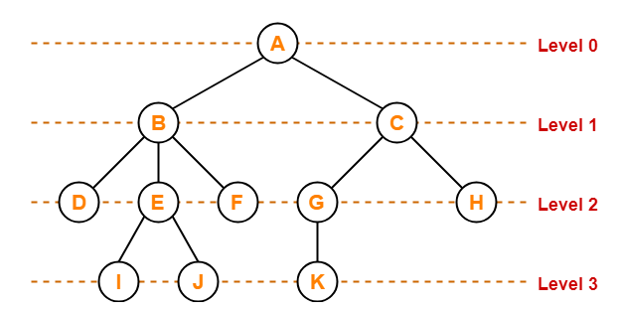
Tree Terminology – Level
Each step of tree is level number
Staring with root as 0

Slide 15
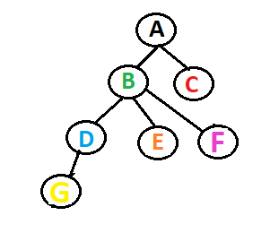
Tree Terminology – Height
Number of edges in longest path from the node to any leaf
Height of any leaf node is 0
Height of Tree = Height of Root node
Height A – 3
Height B – 2
Height D – 1
Height C,G,E,F – 0
Height of tree - 3

Slide 16
Tree Terminology – Depth
Number of edges from root node to particular node is Depth
Depth of root node is 0
Depth of Tree = Depth of longest path from root to leaf
Depth A – 0
Depth B ,C – 1
Depth D, E, F – 2
Depth G – 3
Depth of tree - 3

Slide 17
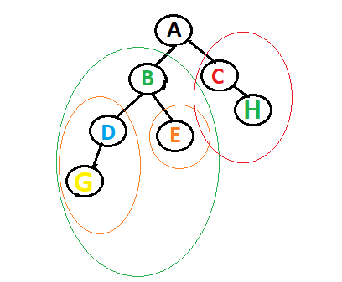
Tree Terminology – Subtree
Each child of a tree forms a subtree recursively

Slide 18
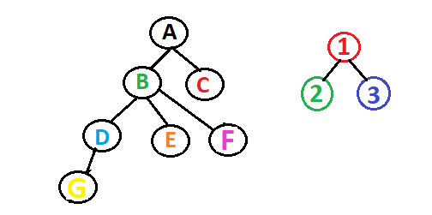
Tree Terminology – Forest
Set of disjoint trees

Slide 19
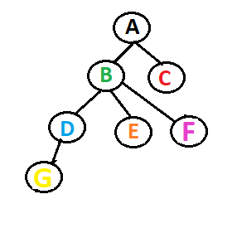
Tree Terminology - Path
A path from node a¹ to a^{k} is defined as a sequence of nodes a¹, a², . . . , a^{k} such that a^{i} is the parent of a^{i+1} for 1 ≤ i < k
Path A-G: A,B,D,G

Slide 20
Tree Terminology – length of Path
Number of edges in the path
Path A-G: A – B – D – G
Length of path A-G : 3

Slide 21
Tree Terminology – Ancestor & Descendant
If there is a path from A to B, then A is an ancestor of B and B is a descendant of A
Path A-G: A – B – D – G
A – Ancestor for G, B, D…
G – Descendant of D,B,A

Slide 22
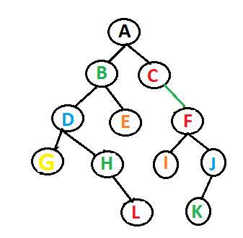
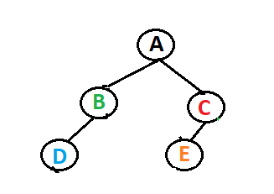
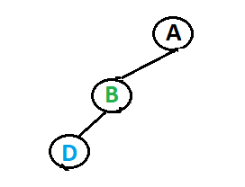
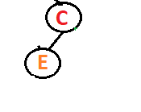
Binary Tree
A binary tree is a data structure specified as a set of so-called node elements. The topmost element in a binary tree is called the root node, and each node has 0, 1, or at most 2 kids.

Slide 23
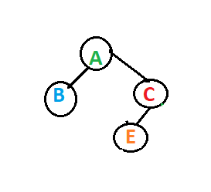
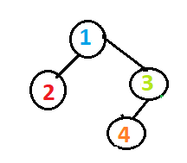
Similar binary tree
Tree with same structure

Slide 24
Copies of Binary Tree
Same structure and same data node

Slide 25
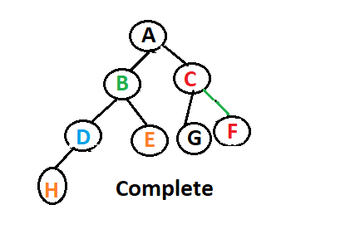
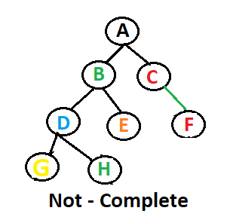
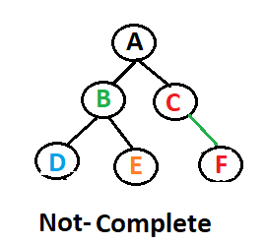
Complete Binary Tree
Except last level, all the nodes need to completely filled
All nodes filled from left to right

Slide 26
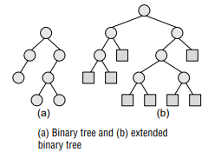
Extended Binary Tree
Each node will have either two child or zero child
Nodes with two children – Internal nodes
Node with no child – External nodes

Slide 27
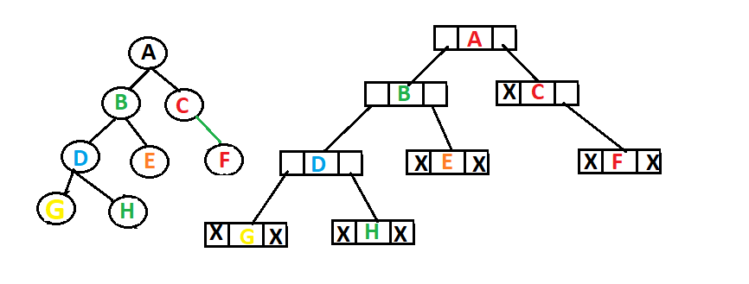
Representation of Binary Tree
Each node – three portion – Data portion, left child pointer, Right child pointer

Slide 28
Linked List Representation of Tree
Struct NODE
{
Struct NODE *leftchild;
Int value;
Struct NODE *rightchild;
};

Slide 29
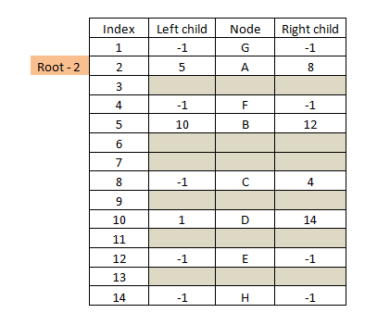
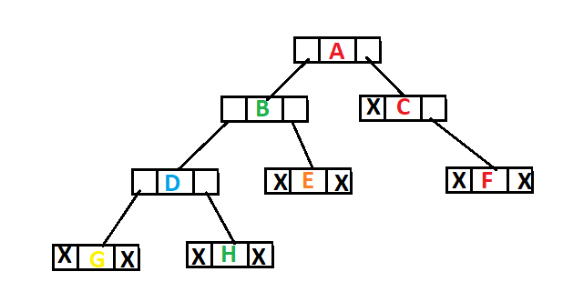
Linked List Representation of Tree

Slide 30
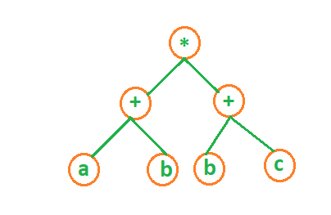
Expression Tree
Used to store algebraic expression
Example 1: exp = (a+b)*(b+c)

Slide 31
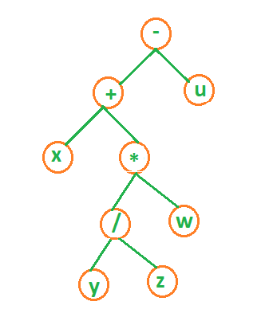
Expression Tree
Used to store algebraic expression
Example 1: exp = x+y/z*w-u
Can be written as: exp = ((x+ ((y/z)*w)-u)

Slide 32
Binary Tree Traversal
Traversal – visiting all node only once
Based on the order of visiting :
In – order traversal
Pre – order traversal
Post – order traversal

Slide 33
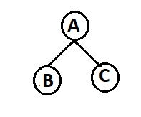
In-order Traversal
Traverse left node , visit root node, Traverse right node
Traverse Left node– B
No left child for B subtree
Visit root node B
No right child for B subtree
Visit root node A
Traverse Right node– C
No left child for C subtree
Visit root node C
No right child for C subtree
B – A – C

Slide 34
In-order Traversal
Algorithm: Inorder(Tree)
Repeat step 2 – 4 while Tree != Null
Inorder(Tree->left)
Write(Tree->Data)
Inorder(Tree->right)
End

Slide 35
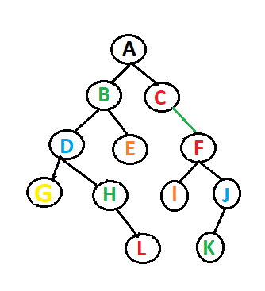
In-order Traversal
Algorithm: Inorder(Tree)
Repeat step 2 – 4 while Tree != Null
Inorder(Tree->left)
Write(Tree->Data)
Inorder(Tree->right)
End

Slide 36
In-order Traversal
Algorithm: Inorder(Tree)
Repeat step 2 – 4 while Tree != Null
Inorder(Tree->left)
Write(Tree->Data)
Inorder(Tree->right)
End

Slide 37
In-order Traversal
Algorithm: Inorder(Tree)
Repeat step 2 – 4 while Tree != Null
Inorder(Tree->left)
Write(Tree->Data)
Inorder(Tree->right)
End

Slide 38
In-order Traversal
Algorithm: Inorder(Tree)
Repeat step 2 – 4 while Tree != Null
Inorder(Tree->left)
Write(Tree->Data)
Inorder(Tree->right)
End

Slide 39
In-order Traversal
Algorithm: Inorder(Tree)
Repeat step 2 – 4 while Tree != Null
Inorder(Tree->left)
Write(Tree->Data)
Inorder(Tree->right)
End
Result : G,

Slide 40
In-order Traversal
Algorithm: Inorder(Tree)
Repeat step 2 – 4 while Tree != Null
Inorder(Tree->left)
Write(Tree->Data)
Inorder(Tree->right)
End
Result : G, D,

Slide 41
In-order Traversal
Algorithm: Inorder(Tree)
Repeat step 2 – 4 while Tree != Null
Inorder(Tree->left)
Write(Tree->Data)
Inorder(Tree->right)
End
Result : G, D,

Slide 42
In-order Traversal
Algorithm: Inorder(Tree)
Repeat step 2 – 4 while Tree != Null
Inorder(Tree->left)
Write(Tree->Data)
Inorder(Tree->right)
End
Result : G, D, H,

Slide 43
In-order Traversal
Algorithm: Inorder(Tree)
Repeat step 2 – 4 while Tree != Null
Inorder(Tree->left)
Write(Tree->Data)
Inorder(Tree->right)
End
Result : G, D, H, L,

Slide 44
In-order Traversal
Algorithm: Inorder(Tree)
Repeat step 2 – 4 while Tree != Null
Inorder(Tree->left)
Write(Tree->Data)
Inorder(Tree->right)
End
Result : G, D, H, L, B

Slide 45
In-order Traversal
Algorithm: Inorder(Tree)
Repeat step 2 – 4 while Tree != Null
Inorder(Tree->left)
Write(Tree->Data)
Inorder(Tree->right)
End
Result : G, D, H, L, B, E

Slide 46
In-order Traversal
Algorithm: Inorder(Tree)
Repeat step 2 – 4 while Tree != Null
Inorder(Tree->left)
Write(Tree->Data)
Inorder(Tree->right)
End
Result : G, D, H, L, B, E, A,

Slide 47
In-order Traversal
Algorithm: Inorder(Tree)
Repeat step 2 – 4 while Tree != Null
Inorder(Tree->left)
Write(Tree->Data)
Inorder(Tree->right)
End
Result : G, D, H, L, B, E, A,

Slide 48
In-order Traversal
Algorithm: Inorder(Tree)
Repeat step 2 – 4 while Tree != Null
Inorder(Tree->left)
Write(Tree->Data)
Inorder(Tree->right)
End
Result : G, D, H, L, B, E, A, C

Slide 49
In-order Traversal
Algorithm: Inorder(Tree)
Repeat step 2 – 4 while Tree != Null
Inorder(Tree->left)
Write(Tree->Data)
Inorder(Tree->right)
End
Result : G, D, H, L, B, E, A, C, I,

Slide 50
In-order Traversal
Algorithm: Inorder(Tree)
Repeat step 2 – 4 while Tree != Null
Inorder(Tree->left)
Write(Tree->Data)
Inorder(Tree->right)
End
Result : G, D, H, L, B, E, A, C, I,
F,

Slide 51
In-order Traversal
Algorithm: Inorder(Tree)
Repeat step 2 – 4 while Tree != Null
Inorder(Tree->left)
Write(Tree->Data)
Inorder(Tree->right)
End
Result : G, D, H, L, B, E, A, C, I,
F,

Slide 52
In-order Traversal
Algorithm: Inorder(Tree)
Repeat step 2 – 4 while Tree != Null
Inorder(Tree->left)
Write(Tree->Data)
Inorder(Tree->right)
End
Result : G, D, H, L, B, E, A, C, I,
F, K,

Slide 53
In-order Traversal
Algorithm: Inorder(Tree)
Repeat step 2 – 4 while Tree != Null
Inorder(Tree->left)
Write(Tree->Data)
Inorder(Tree->right)
End
Result : G, D, H, L, B, E, A, C, I,
F, K, J

Slide 54
In-order Traversal
Algorithm: Inorder(Tree)
Repeat step 2 – 4 while Tree != Null
Inorder(Tree->left)
Write(Tree->Data)
Inorder(Tree->right)
End
Result : G, D, H, L, B, E, A, C, I,
F, K, J

Slide 55
Pre – order Traversal
Visit root node, Traverse left node , Traverse right node
Visit root node A
Traverse Left node– B
Visit root node B
No left child for B subtree
No right child for B subtree
Traverse Right node– C
Visit root node C
No left child for C subtree
No right child for C subtree
A – B – C

Slide 56
Pre-order Traversal
Algorithm: Preorder(Tree)
Repeat step 2 – 4 while Tree != Null
Write(Tree->Data)
Preorder(Tree->left)
Preorder(Tree->right)
End

Slide 57
Pre-order Traversal
Algorithm: Preorder(Tree)
Repeat step 2 – 4 while Tree != Null
Write(Tree->Data)
Preorder(Tree->left)
Preorder(Tree->right)
End
Result: A,

Slide 58
Pre-order Traversal
Algorithm: Preorder(Tree)
Repeat step 2 – 4 while Tree != Null
Write(Tree->Data)
Preorder(Tree->left)
Preorder(Tree->right)
End
Result: A,

Slide 59
Pre-order Traversal
Algorithm: Preorder(Tree)
Repeat step 2 – 4 while Tree != Null
Write(Tree->Data)
Preorder(Tree->left)
Preorder(Tree->right)
End
Result: A, B,

Slide 60
Pre-order Traversal
Algorithm: Preorder(Tree)
Repeat step 2 – 4 while Tree != Null
Write(Tree->Data)
Preorder(Tree->left)
Preorder(Tree->right)
End
Result: A, B,

Slide 61
Pre-order Traversal
Algorithm: Preorder(Tree)
Repeat step 2 – 4 while Tree != Null
Write(Tree->Data)
Preorder(Tree->left)
Preorder(Tree->right)
End
Result: A, B, D,

Slide 62
Pre-order Traversal
Algorithm: Preorder(Tree)
Repeat step 2 – 4 while Tree != Null
Write(Tree->Data)
Preorder(Tree->left)
Preorder(Tree->right)
End
Result: A, B, D,G,

Slide 63
Pre-order Traversal
Algorithm: Preorder(Tree)
Repeat step 2 – 4 while Tree != Null
Write(Tree->Data)
Preorder(Tree->left)
Preorder(Tree->right)
End
Result: A, B, D, G,

Slide 64
Pre-order Traversal
Algorithm: Preorder(Tree)
Repeat step 2 – 4 while Tree != Null
Write(Tree->Data)
Preorder(Tree->left)
Preorder(Tree->right)
End
Result: A, B, D, G, H,

Slide 65
Pre-order Traversal
Algorithm: Preorder(Tree)
Repeat step 2 – 4 while Tree != Null
Write(Tree->Data)
Preorder(Tree->left)
Preorder(Tree->right)
End
Result: A, B, D, G, H, L,

Slide 66
Pre-order Traversal
Algorithm: Preorder(Tree)
Repeat step 2 – 4 while Tree != Null
Write(Tree->Data)
Preorder(Tree->left)
Preorder(Tree->right)
End
Result: A, B, D, G, H, L, E,

Slide 67
Pre-order Traversal
Algorithm: Preorder(Tree)
Repeat step 2 – 4 while Tree != Null
Write(Tree->Data)
Preorder(Tree->left)
Preorder(Tree->right)
End
Result: A, B, D, G, H, L, E,

Slide 68
Pre-order Traversal
Algorithm: Preorder(Tree)
Repeat step 2 – 4 while Tree != Null
Write(Tree->Data)
Preorder(Tree->left)
Preorder(Tree->right)
End
Result: A, B, D, G, H, L, E, C,

Slide 69
Pre-order Traversal
Algorithm: Preorder(Tree)
Repeat step 2 – 4 while Tree != Null
Write(Tree->Data)
Preorder(Tree->left)
Preorder(Tree->right)
End
Result: A, B, D, G, H, L, E, C,

Slide 70
Pre-order Traversal
Algorithm: Preorder(Tree)
Repeat step 2 – 4 while Tree != Null
Write(Tree->Data)
Preorder(Tree->left)
Preorder(Tree->right)
End
Result: A, B, D, G, H, L, E, C, F,

Slide 71
Pre-order Traversal
Algorithm: Preorder(Tree)
Repeat step 2 – 4 while Tree != Null
Write(Tree->Data)
Preorder(Tree->left)
Preorder(Tree->right)
End
Result: A, B, D, G, H, L, E, C, F,
I,

Slide 72
Pre-order Traversal
Algorithm: Preorder(Tree)
Repeat step 2 – 4 while Tree != Null
Write(Tree->Data)
Preorder(Tree->left)
Preorder(Tree->right)
End
Result: A, B, D, G, H, L, E, C, F,
I, J,

Slide 73
Pre-order Traversal
Algorithm: Preorder(Tree)
Repeat step 2 – 4 while Tree != Null
Write(Tree->Data)
Preorder(Tree->left)
Preorder(Tree->right)
End
Result: A, B, D, G, H, L, E, C, F,
I, J, K

Slide 74
Pre-order Traversal
Algorithm: Preorder(Tree)
Repeat step 2 – 4 while Tree != Null
Write(Tree->Data)
Preorder(Tree->left)
Preorder(Tree->right)
End
Result: A, B, D, G, H, L, E, C, F,
I, J, K

Slide 75
Post– order Traversal
Traverse left node, Traverse right node , visit root node
Traverse Left node – B
No left child for B subtree
No right child for B subtree
Visit root node B
Traverse Right node– C
No left child for C subtree
No right child for C subtree
Visit root node C
Visit root node A
B – C – A

Slide 76
Post-order Traversal
Algorithm: Postorder(Tree)
Repeat step 2 – 4 while Tree != Null
Postorder(Tree->left)
Postorder(Tree->right)
Write(Tree->Data)
End

Slide 77
Post-order Traversal
Algorithm: Postorder(Tree)
Repeat step 2 – 4 while Tree != Null
Postorder(Tree->left)
Postorder(Tree->right)
Write(Tree->Data)
End

Slide 78
Post-order Traversal
Algorithm: Postorder(Tree)
Repeat step 2 – 4 while Tree != Null
Postorder(Tree->left)
Postorder(Tree->right)
Write(Tree->Data)
End

Slide 79
Post-order Traversal
Algorithm: Postorder(Tree)
Repeat step 2 – 4 while Tree != Null
Postorder(Tree->left)
Postorder(Tree->right)
Write(Tree->Data)
End

Slide 80
Post-order Traversal
Algorithm: Postorder(Tree)
Repeat step 2 – 4 while Tree != Null
Postorder(Tree->left)
Postorder(Tree->right)
Write(Tree->Data)
End
Result : G,

Slide 81
Post-order Traversal
Algorithm: Postorder(Tree)
Repeat step 2 – 4 while Tree != Null
Postorder(Tree->left)
Postorder(Tree->right)
Write(Tree->Data)
End
Result : G,

Slide 82
Post-order Traversal
Algorithm: Postorder(Tree)
Repeat step 2 – 4 while Tree != Null
Postorder(Tree->left)
Postorder(Tree->right)
Write(Tree->Data)
End
Result : G, L,

Slide 83
Post-order Traversal
Algorithm: Postorder(Tree)
Repeat step 2 – 4 while Tree != Null
Postorder(Tree->left)
Postorder(Tree->right)
Write(Tree->Data)
End
Result : G, L, H,

Slide 84
Post-order Traversal
Algorithm: Postorder(Tree)
Repeat step 2 – 4 while Tree != Null
Postorder(Tree->left)
Postorder(Tree->right)
Write(Tree->Data)
End
Result : G, L, H, D

Slide 85
Post-order Traversal
Algorithm: Postorder(Tree)
Repeat step 2 – 4 while Tree != Null
Postorder(Tree->left)
Postorder(Tree->right)
Write(Tree->Data)
End
Result : G, L, H, D, E,

Slide 86
Post-order Traversal
Algorithm: Postorder(Tree)
Repeat step 2 – 4 while Tree != Null
Postorder(Tree->left)
Postorder(Tree->right)
Write(Tree->Data)
End
Result : G, L, H, D, E, B,

Slide 87
Post-order Traversal
Algorithm: Postorder(Tree)
Repeat step 2 – 4 while Tree != Null
Postorder(Tree->left)
Postorder(Tree->right)
Write(Tree->Data)
End
Result : G, L, H, D, E, B,

Slide 88
Post-order Traversal
Algorithm: Postorder(Tree)
Repeat step 2 – 4 while Tree != Null
Postorder(Tree->left)
Postorder(Tree->right)
Write(Tree->Data)
End
Result : G, L, H, D, E, B,

Slide 89
Post-order Traversal
Algorithm: Postorder(Tree)
Repeat step 2 – 4 while Tree != Null
Postorder(Tree->left)
Postorder(Tree->right)
Write(Tree->Data)
End
Result : G, L, H, D, E, B, I,

Slide 90
Post-order Traversal
Algorithm: Postorder(Tree)
Repeat step 2 – 4 while Tree != Null
Postorder(Tree->left)
Postorder(Tree->right)
Write(Tree->Data)
End
Result : G, L, H, D, E, B, I,

Slide 91
Post-order Traversal
Algorithm: Postorder(Tree)
Repeat step 2 – 4 while Tree != Null
Postorder(Tree->left)
Postorder(Tree->right)
Write(Tree->Data)
End
Result : G, L, H, D, E, B, I, K,

Slide 92
Post-order Traversal
Algorithm: Postorder(Tree)
Repeat step 2 – 4 while Tree != Null
Postorder(Tree->left)
Postorder(Tree->right)
Write(Tree->Data)
End
Result : G, L, H, D, E, B, I, K, J,

Slide 93
Post-order Traversal
Algorithm: Postorder(Tree)
Repeat step 2 – 4 while Tree != Null
Postorder(Tree->left)
Postorder(Tree->right)
Write(Tree->Data)
End
Result : G, L, H, D, E, B, I, K, J,
F,

Slide 94
Post-order Traversal
Algorithm: Postorder(Tree)
Repeat step 2 – 4 while Tree != Null
Postorder(Tree->left)
Postorder(Tree->right)
Write(Tree->Data)
End
Result : G, L, H, D, E, B, I, K, J,
F, C,

Slide 95
Post-order Traversal
Algorithm: Postorder(Tree)
Repeat step 2 – 4 while Tree != Null
Postorder(Tree->left)
Postorder(Tree->right)
Write(Tree->Data)
End
Result : G, L, H, D, E, B, I, K, J,
F, C, A

Slide 96
Post-order Traversal
Algorithm: Postorder(Tree)
Repeat step 2 – 4 while Tree != Null
Postorder(Tree->left)
Postorder(Tree->right)
Write(Tree->Data)
End
Result : G, L, H, D, E, B, I, K, J,
F, C, A

Slide 97
Threaded Binary Trees
Nodes that does not have right child, have a thread to their inorder successor.
Node structure:
Struct NODE1
{
struct NODE1 *lchild;
int Node1_data;
Struct NODE1 *rchild;
Struct NODE1*trd;
}

Slide 98
Threaded Binary Trees
Consider the following tree:
Inorder traversal : D B A E C

Slide 99
Threaded Binary Trees
Consider the following tree:
Inorder traversal : D B A E C
No Right Child for D – inorder traversal B comes after D

Slide 100
Threaded Binary Trees
Consider the following tree:
Inorder traversal : D B A E C
No Right Child for D – inorder traversal B comes after D
Create a thread from D to B

Slide 101
Threaded Binary Trees
Consider the following tree:
Inorder traversal : D B A E C
No Right Child for B – inorder traversal A comes after B
Create a thread from B to A

Slide 102
Threaded Binary Trees
Consider the following tree:
Inorder traversal : D B A E C
No Right Child for E – inorder traversal C comes after E
Create a thread from E to C

Slide 103
Threaded Binary Trees
Consider the following tree:
Inorder traversal : D B A E C
No Right Child for C – inorder traversal C comes at end
Create a hanging tread (dangling thread)

Slide 104
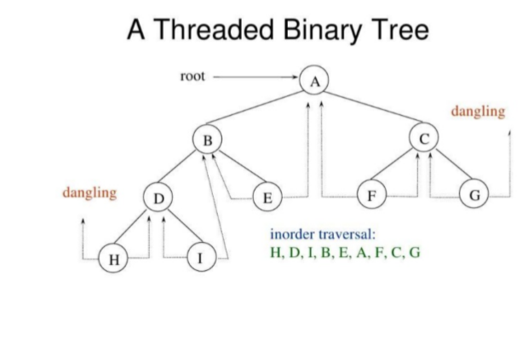
Threaded Binary Trees

Slide 105

Session- 7
BINARY SEARCH TREE

Slide 106
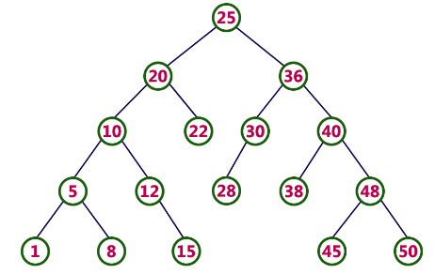
BINARY SEARCH TREE
Binary Search Tree is a binary tree in which every node contains only smaller values in its left sub tree and only larger values in its right sub tree.
Also called as ORDERED binary tree
BST– properties:
It should be Binary tree.
Left subtree < Root Node < = Right subtree (or)
Left subtree < =Root Node < Right subtree
Example:

Slide 107
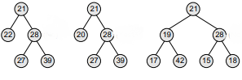
Binary search trees or not ?

Slide 108
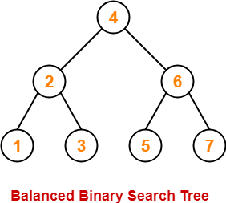
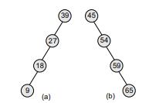
Operations: Searching, Insertion, Deletion of a Node
TimeComplexity :
BEST CASE | WORST CASE
Search Operation - O(log n) Insertion Operation- O(log n) Deletion Operation - O(log n) Example: | Search Operation - O(n) Insertion Operation- O(1) Deletion Operation - O(n) (note:Height of the binary search tree becomes n) Example: (a) Left skewed, and (b) right skewed binary search trees

Slide 109
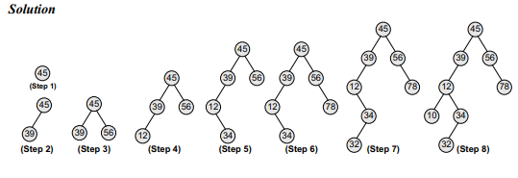
Binary search tree Construction
Create a binary search tree using the following data elements: 45, 39, 56, 12, 34, 78, 32, 10, 89, 54, 67, 81

Slide 110
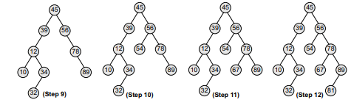
Remaining: 89, 54, 67, 81

Slide 111
SEARCHING A NODE IN BST
SearchElement (TREE, VAL)
Step 1: IF TREE DATA = VAL OR TREE = NULL
Return TREE
ELSE
IF VAL < TREE DATA
Return searchElement(TREE LEFT, VAL)
ELSE
Return searchElement(TREE RIGHT, VAL)
[END OF IF]
[END OF IF]
Step 2: END

Slide 112
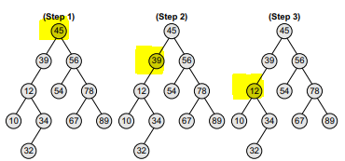
EXAMPLE 1: Searching a node with value 12 in the given binary search tree
We start our search from the root node 45.
As 12 < 45, so we search in 45’s LEFT subtree.
As 12 < 39, so we search in 39’s LEFT subtree.
So, we conclude that 12 is present in the above BST.

Slide 113
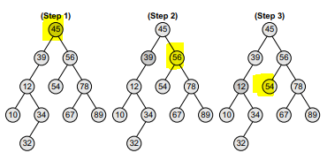
EXAMPLE 2: Searching a node with value 52 in the given binary search tree
We start our search from the root node 45.
As 52 > 45, so we search in 45’s RIGHT subtree.
As 52 < 56 so we search in 56’s LEFT subtree.
As 52 < 54 so we search in 54’s LEFT subtree.
But 54 is leaf node
So, we conclude that 52 is not present in the above BST.

Slide 114
INSERTING A NODE IN BST
Insert (TREE, VAL)
Step 1: IF TREE = NULL
Allocate memory for TREE
SET TREE DATA = VAL
SET TREE LEFT = TREE RIGHT = NULL
ELSE
IF VAL < TREE DATA
Insert(TREE LEFT, VAL)
ELSE
Insert(TREE RIGHT, VAL)
[END OF IF]
[END OF IF]
Step 2: END

Slide 115
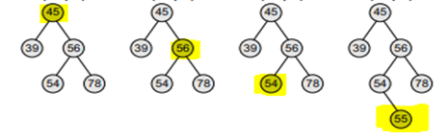
EXAMPLE : Inserting nodes with values 55 in the given binary search tree
We start searching for value 55 from the root node 45.
As 55 > 45, so we search in 45’s RIGHT subtree.
As 55 < 56 so we search in 56’s LEFT subtree.
As 55 > 54 so so we add 55 to 54’s right subtree.

Slide 116
Deletion Operation in BST
Case 1: Deleting a Leaf node (A node with no children)
Case 2: Deleting a node with one child
Case 3: Deleting a node with two children
Delete (TREE, VAL)
Step 1: IF TREE = NULL
Write "VAL not found in the tree"
ELSE IF VAL < TREE DATA
Delete(TREE->LEFT, VAL)
ELSE IF VAL > TREE DATA
Delete(TREE RIGHT, VAL)
ELSE IF TREE LEFT AND TREE RIGHT
SET TEMP = findLargestNode(TREE LEFT) ( INORDER PREDECESSOR)
(OR)
SET TEMP = findSmallestNode(TREE RIGHT) ( INORDER SUCESSOR)
SET TREE DATA = TEMP DATA
Delete(TREE LEFT, TEMP DATA) (OR) Delete(TREE RIGHT, TEMP DATA)
ELSE
SET TEMP = TREE
IF TREE LEFT = NULL AND TREE RIGHT = NULL
SET TREE = NULL
ELSE IF TREE LEFT != NULL
SET TREE = TREE LEFT
ELSE
SET TREE = TREE RIGHT
[END OF IF]
FREE TEMP
[END OF IF]
Step 2: END

Slide 117
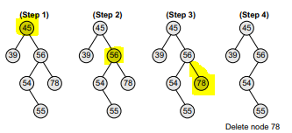
Case 1: Deleting a Leaf node (A node with no children) EXAMPLE : Deleting node 78 from the given binary search tree

Slide 118
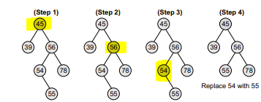
Case 2: Deleting a node with one child EXAMPLE : Deleting node 54 from the given binary search tree

Slide 119
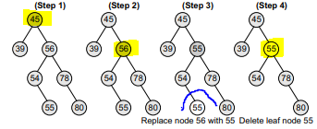
Case 3: Deleting a node with two children EXAMPLE 1 : Deleting node 56 from the given binary search tree
Visit to the left sub tree of the deleting node.
Grab the greatest value element called as in-order predecessor.
Replace the deleting element with its in-order predecessor.

Slide 120
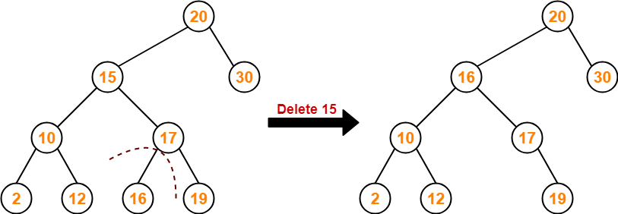
EXAMPLE 2 : Deleting node 15 from the given binary search tree
Visit to the right sub tree of the deleting node.
Pluck the least value element called as inorder successor.
Replace the deleting element with its inorder successor.

Slide 121
Other possible operations:
Determining the height of a tree
Determining the no of nodes a tree
Determining the no of internal nodes
Determining the no of external nodes
Determining the mirror images
Removing the tree
Finding the smallest node
Finding the largest node

Slide 122
Session-8
AVL TREE

Slide 123
AVL TREE
Named after Adelson-Velskii and Landis as AVL tree
Also called as self-balancing binary search tree
AVL tree – properties:
It should be Binary search tree
Balancing factor: balance of every node is either -1 or 0 or 1 where balance(node) = height(node.left subtree) – height(node.right subtree)
Maximum possible number of nodes in AVL tree of height H
= 2^{H+1} – 1
Operations: Searching, Insertion, Deletion of a Node
TimeComplexity : O(log n)

Slide 124
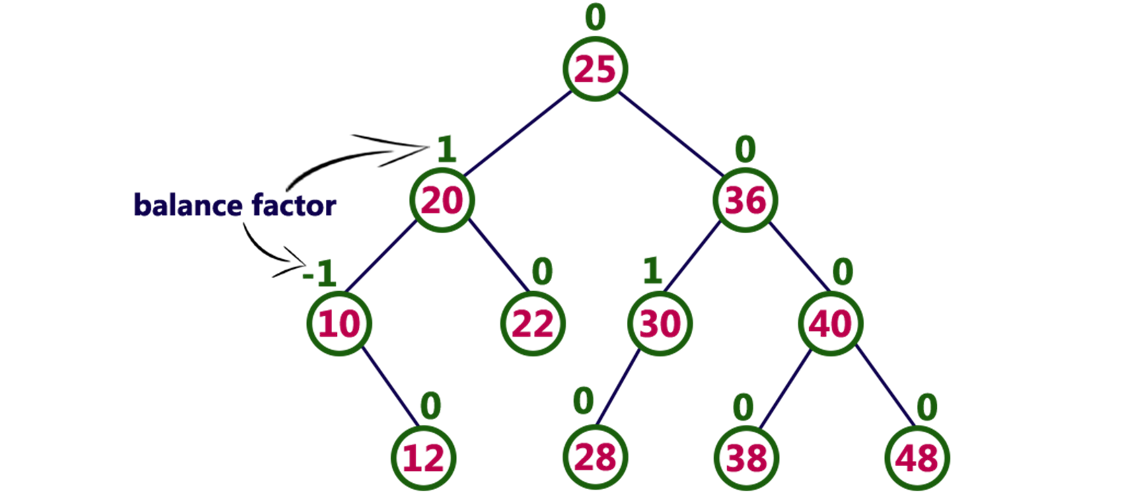
Balancing Factor
Balance factor = heightOfLeftSubtree – heightOfRightSubtree

Slide 125
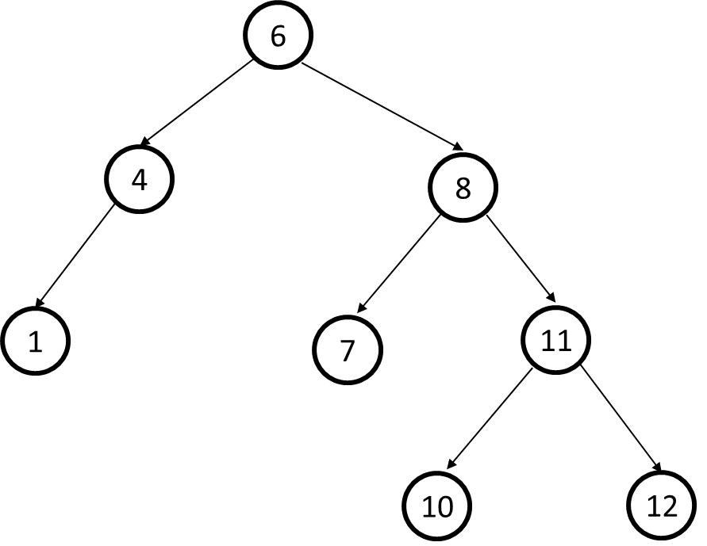
Example 1 : Check - AVL Tree?

Slide 126
Example 2: Check - AVL Tree?
6
4
8
1
5
7
11
3
2

Slide 127
operations on AVL tree
SEARCHING
INSERTION
DELETION

Slide 128
Search Operation in AVL Tree
ALGORITHM:
STEPS:
1 : Get the search element
2 : check search element == root node in the tree.
3 : If both are exact match, then display “element found" and end.
4 : If both are not matched, then check whether search element is < or > than that node value.
5: If search element is < then continue search in left sub tree.
6: If search element is > then continue search in right sub tree.
7: Repeat the step from 1 to 6 until we find the exact element
8: Still the search element is not found after reaching the leaf node display “element not found”.

Slide 129
INSERTION or DELETION
After performing any operation on AVL tree - the balance factor of each node is to be checked.
After insertion or deletion there exists either any one of the following:
Scenario 1:
After insertion or deletion , the balance factor of each node is either 0 or 1 or -1.
If so AVL tree is considered to be balanced.
The operation ends.
Scenario 1:
After insertion or deletion, the balance factor is not 0 or 1 or -1 for at least one node then
The AVL tree is considered to be imbalanced.
If so, Rotations are need to be performed to balance the tree in order to make it as AVL TREE.

Slide 130
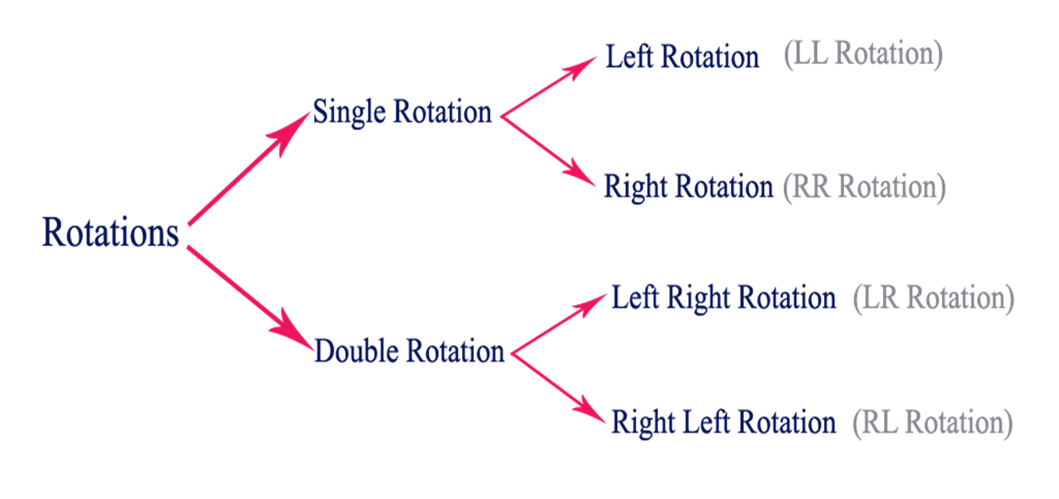
AVL TREE ROTATION

Slide 131
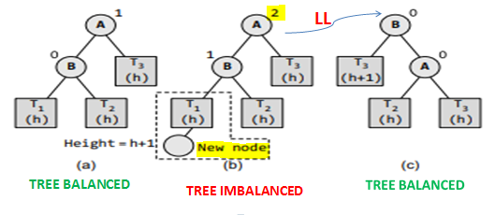
LL ROTATION
When new node is inserted in the left sub-tree of the left sub-tree of the critical

Slide 132



LL ROTATION- Example

Slide 133

RR ROTATION
When new node is inserted in the right sub-tree of the right sub-tree of the critical

Slide 134

RR Rotation - Example

Slide 135


LR ROTATION
When new node is inserted in the left sub-tree of the right sub-tree of the critical

Slide 136

LR Rotation - Example

Slide 137

RL ROTATION
When new node is inserted in the right sub-tree of the left sub-tree of the critical

Slide 138

RL Rotation - Example

Slide 139

AVL TREE CONSTRUCTION / NODE INSERTION - Example
Construct an AVL tree by inserting the following elements in the given order 63, 9, 19, 27, 18, 108, 99, 81.

Slide 140

AVL TREE – NODE DELETION - Example
Delete nodes 52, 36, and 61 from the AVL tree given

Slide 141
Construct AVL Tree
35, 15,5,20,25
,17,45

Slide 142
B-Trees

Slide 143
B-Trees
A B-tree is called as an m-way tree where each node is allowed to have a maximum of m children.
Its order is m.
The number of keys in each non-leaf node is m-1.
Leaves should be in the same level and should contain no more than m-1 keys.
Non-leaf nodes except the root have at least ⎡m / 2⎤ children.
The root can be either leaf node or it can have two to m children.

Slide 144
Structure of an m-way search tree node
The structure of an m-way search tree node is shown in figure
Where P0 , P1 , P2 , ..., Pn are pointers to the node’s sub-trees and K0 , K1 , K2 , ..., Kn–1 are the key values of the node.
All the key values are stored in ascending order.
A B tree is a specialized m-way tree developed by Rudolf Bayer and Ed McCreight in 1970 that is widely used for disk access.

Slide 145


B-Trees - Examples
B-Tree of order 3
B-Tree of order 4

Slide 146
Searching in a B-Tree
Similar to searching in a binary search tree.
Consider the B-Tree shown here.
If we wish to search for 72 in this tree, first consider
the root, the search key is greater than the values in
the root node. So go to the right sub-tree.
The right sub tree consists of two values and again 72 is greater than 63 so traverse to right sub tree of 63.
The right sub tree consists of two values 72 and 81. So we found our value 72.

Slide 147
Insertion in a B-Tree
Insertions are performed at the leaf level.
Search the B-Tree to find suitable place to insert the new element.
If the leaf node is not full, the new element can be inserted in the leaf level.
If the leaf is full,
insert the new element in order into the existing set of keys.
split the node at its median into two nodes.
push the median element up to its parent’s node. If the parent’s node is already full, then split the parent node by following the same steps.

Slide 148


Insertion - Example
Consider the B-Tree of order 5
Try to insert 8, 9, 39 and 4 into it.

Slide 149


Insertion - Example

Slide 150

Exercise
Consider the B-Tree of order 3, try to insert 121 and 87.
Create a B-Tree of order 5, by inserting the following elements
3, 14, 7, 1, 8, 5, 11, 17, 13, 6, 23, 12, 20, 26, 4, 16, 18, 24, 25, and 19.

Slide 151
Deletion in a B-Tree
Like insertion, deletion also should be performed from leaf nodes.
There are two cases in deletion.
To delete a leaf node.
To delete an internal node.
Deleting leaf node
Search for the element to be deleted, if it is in the leaf node and the leaf node has more than m/2 elements then delete the element.
If the leaf node does not contain m/2 elements then take an element from either left or right sub tree.
If both the left and right sub tree contain only minimum number of elements then create a new leaf node.

Slide 152
Deletion in a B-Tree
Deleting an internal node
If the element to be deleted is in an internal node then find the predecessor or successor of the element to be deleted and place it in the deleted element position.
The predecessor or successor of the element to be deleted will always be in the leaf node.
So the procedure will be similar to deleting an element from the leaf node.

Slide 153


Deletion - Example
Consider the B-Tree of order 5
Try to delete values 93, 201, 180 and 72 from it.

Slide 154

Deletion - Example

Slide 155

Deletion - Example

Slide 156

Exercise
Consider the B-Tree of order 3, try to delete 36 and 109

Slide 157
Splay Trees
Self-balancing BST with an additional property that recently accessed elements can be re-accessed fast.
All operations can be performed in O(log n) time.
All operations can be performed by combining with the basic operation called splaying.
Splaying the tree for a particular node rearranges the tree to place that node at the root.
Each splay step depends on three factors:
Whether N is the left or right child of its parent P,
Whether P is the root or not, and if not,
Whether P is the left or right child of its parent, G (N’s grandparent).

Slide 158


Slide 159


Slide 160


Slide 161


Slide 162


Slide 163


Slide 164

Splay Trees
Zig – Zag Step

Slide 165
RED -BLACK TREE

Slide 166


Slide 167



Slide 168



Slide 169


Slide 170


Slide 171


Slide 172


Slide 173


Slide 174


Slide 175


Slide 176


Slide 177

Red-Black Tree - Example

Slide 178


Exercise
Say whether the following trees are red-black or not.

Slide 179
Red Black Trees - Insertion
Insertion operation starts in the same way as we add new node in the BST.
The difference is, in BST the new node is added as a leaf node whereas in red-black tree there is no data in the leaf node.
So we add the new node as a red interior node which has two black child nodes.
When a new node is added, it may violate some properties of the red-black tree.
So in order to restore their property, we check for certain cases and restore the property depending on the case that turns up after insertion.
Terminology
Grandparent node (G) of node (N) - parent of N’s parent (P)
Uncle node (U) of node (N) - sibling of N’s parent (P)

Slide 180
Red Black Trees - Insertion
When we insert a new node in a red-black tree, note the following:
All leaf nodes are always black. So property 3 always holds true.
Property 4 (both children of every red node are black) is threatened only by adding a red node, repainting a black node red, or a rotation.
Property 5 (all paths from any given node to its leaf nodes has equal number of black nodes) is threatened only by adding a black node, repainting a red node black, or a rotation.
Case 1: The new node N is added as the root of the Tree
In this case, N is repainted black, as the root should be black always.
Case 2: The new node’s parent P is black
In this case, both children of every red node are black, so Property 4 is not invalidated. Property 5 is also not threatened.

Slide 181

Red Black Trees - Insertion
Case 3: If Both the Parent (P) and the Uncle (U) are Red
In this case, Property 5 which says all paths from any given node to its leaf nodes have an equal number of black nodes is violated.

Slide 182

Red Black Trees - Insertion
Case 4: The Parent P is Red but the Uncle U is Black and N is the Right Child of P and P is the Left Child of G

Slide 183

Red Black Trees - Insertion
Case 5: The parent P is red but the uncle U is black and the new node N is the left child of P, and P is the left child of its parent G.

Slide 184
References
1. Reema Thareja, Data Structures Using C, 1st ed., Oxford Higher Education, 2011
2. Thomas H Cormen, Charles E Leiserson, Ronald L Revest, Clifford Stein, Introduction to Algorithms 3rd ed., The MIT Press Cambridge, 2014
3. Mark Allen Weiss, Data Structures and Algorithm Analysis in C, 2nd ed., Pearson Education, 2015
4.http://masterraghu.com/subjects/Datastructures/ebooks/rema%20thareja.pdf

